Slide 1



Part- 03
Arvind Kharwal
http://www.kharwal.com

Slide 2
Line plot in Matplotlib

Slide 3
Line Plots:
Line plots can be created by Matplotlib's pyplot library.
To build a line plot, first import Matplotlib. It is a standard convention to import Matplotlib's pyplot library as plt.
To build first plot, we will also use numpy library.

Slide 4
To create a line plot, pass an array or list of numbers as an argument to Matplotlib's plt.plot() function. The command plt.show() is needed at the end to show the plot.
plt.plot(x, y)
plt.show()

Slide 5
Features of a Matplotlib plot:
The following is a list of commonly defined features:
Line Color, Line Width, Line Style, Line Opacity and Marker Options.
The color, width, and style of line in a Matplotlib plot can be specified.

Slide 6
Syntax:
plt.plot(<x-data>,<y-data>,
linewidth=<float or int>,
linestyle='<linestyle abbreviation>',
color='<color abbreviation>',
alpha=<float or int>,
marker='<marker abbreviation>')

Slide 7
An example plt.plot() function call including line color, line width, and line style options is:
plt.plot(x, y,
linewidth=2.0,
linestyle='+',
color='b',
alpha=0.5,
marker='o')

Slide 8
List of line widths:
linewidth=<float or int> Line Width
0.5 0.5 pixels wide
1 1 pixel wide
1.5 1.5 pixels wide
2 2 pixels wide
3 3 pixels wide

Slide 9
List of line styles:
linestyle='<style abbreviation>' Line Style
'-' or 'solid' solid line (default)
'--' or 'dashed' dashed line
'-.' or 'dashdot' dash-dot line
':' or 'dotted' dotted line
'None' or ' ' or '' no line

Slide 10
List of color abbreviations:
color ='<color abbreviation>' Color Name
'b' blue
'c' cyan
'g' green
'k' black
'm' magenta
'r' red
'w' white
'y' yellow

Slide 11
Colors can also be specified in hexadecimal form surrounded by quotation marks like '#FF69B4' or in RGBA (red, green, blue, opacity) color surrounded by parenthesis like (255,182,193,0.5).
color ='<color abbreviation>' Color Format
'#FF69B4' hexadecimal
(255,182,193,0.5) RGBA

Slide 12
List of alpha values (opacity): any alpha value between 0.0 and 1.0 is possible.
alpha = <float or int> Opacity
0 transparent
0.5 half transparent
1.0 opaque

Slide 13
List of maker styles:
marker='<marker abbreviation>' Marker Style
'.' point
',' one pixel
'o' circle
'v' triangle_down
'^' triangle_up
'8' octagon
's' square
'p' pentagon
'*' star

Slide 14
'h' hexagon 1
'H' hexagon 2
'+' plus
'P' filled plus
'x' x
'X' filled x
'D' diamond
'd' thin diamond

Slide 15
Title:
The plot title will be shown above the plot. The plt.title() command accepts a string as an argument.
plt.title('My Plot Title')

Slide 16
x-axis label:
The x-axis label is shown below the x-axis. The plt.xlabel() command accepts a string as an argument.
plt.xlabel('My x-axis label')

Slide 17
y-axis label:
The y-axis label is shown to the left of the y-axis. The plt.ylabel() command also accepts a string as an argument.
plt.ylabel('My y-axis label')

Slide 18
Legend:
You can use the plt.legend() command to insert a legend on a plot.
The legend appears within the plot area, in the upper right corner by default.
The plt.legend() command accepts a list of strings and optionally accepts a loc= argument to specify the legend location.
plt.legend(['entry1','entry2'], loc = 0)

Slide 19
The following are the legend location codes. These numbers need to be placed after loc= in the plt.legend() call.
Legend Location loc = <number>
'best' 0
'upper right' 1
'upper left' 2
'lower left' 3
'lower right' 4
'right' 5

Slide 20
'center left' 6
'center right' 7
'lower center' 8
'upper center' 9
'center' 10

Slide 21
Grid:
A grid can be added to a Matplotlib plot using the plt.grid() command. By defaut, the grid is turned off.
To turn on the grid use: plt.grid(True)
The only valid options are plt.grid(True) and plt.grid(False).

Slide 22
Tick Labels:
Tick labels can be specified on a Matplotlib plot using plt.xticks() and plt.yticks().
To add tick labels use:
plt.xticks([locations list],[labels list])
plt.yticks([locations list],[labels list])
The [locations list] can be a Python list or NumPy array of tick locations . The [labels list] is a Python list or NumPy array of strings.

Slide 30
Types of Plot

Slide 31
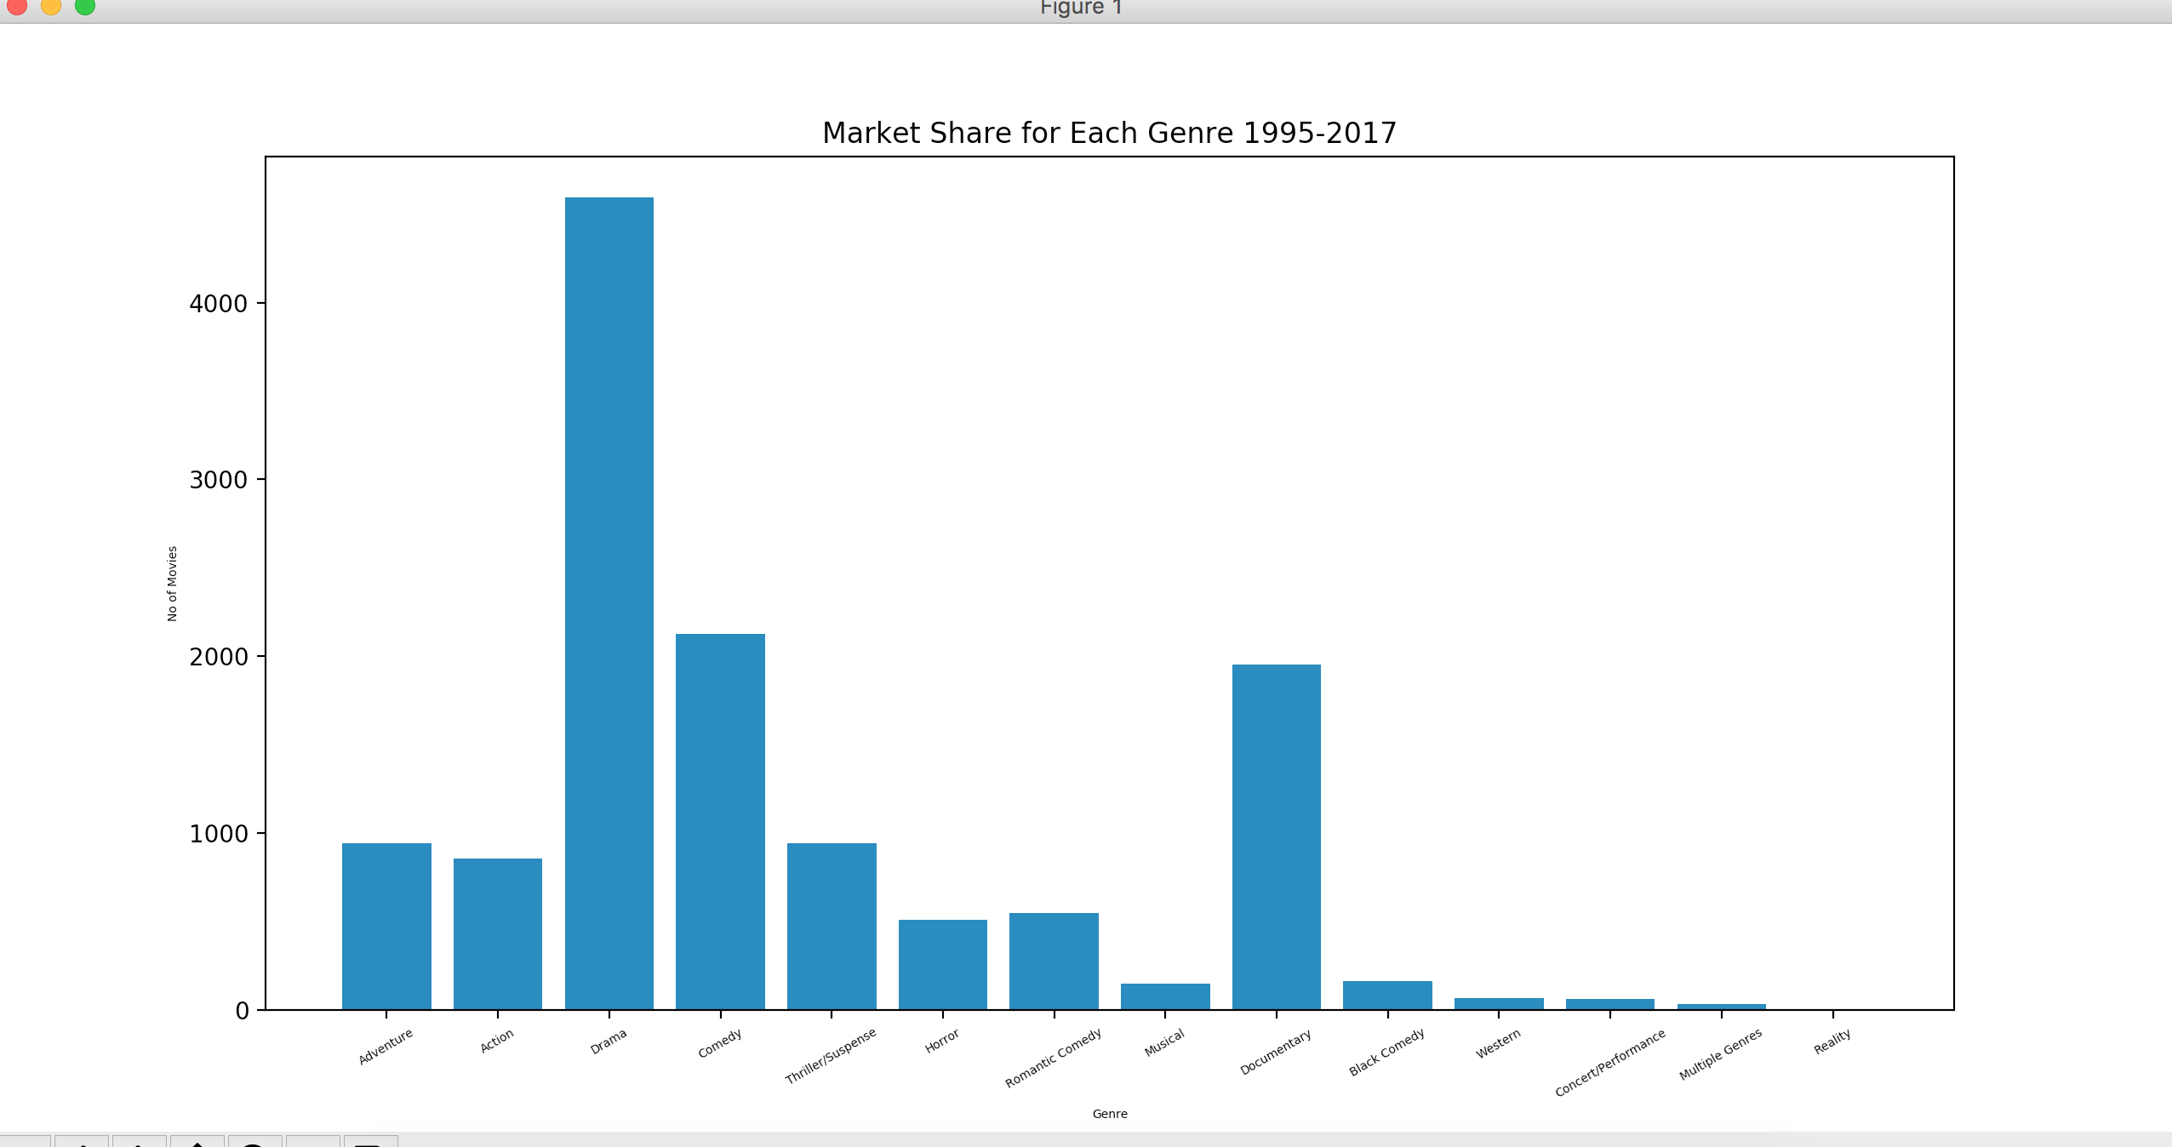
Bar Graph

Slide 32
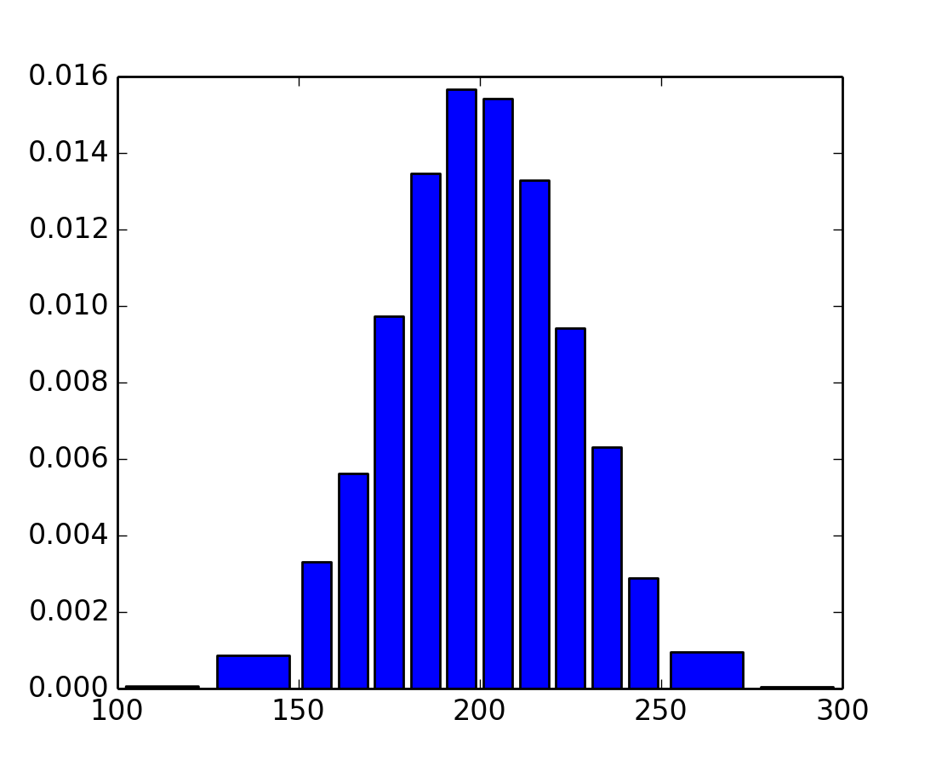
Histogram Graph

Slide 33
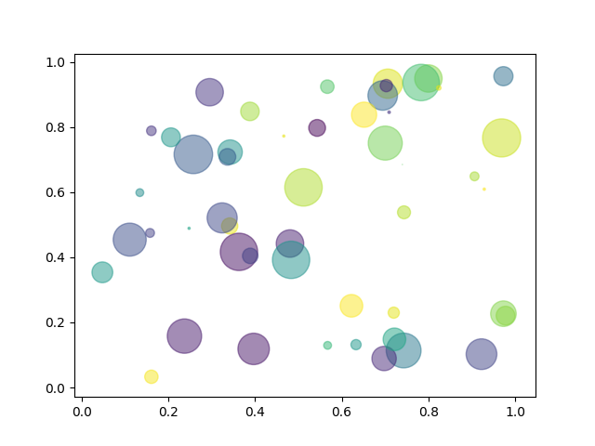
Scatter Plot

Slide 34
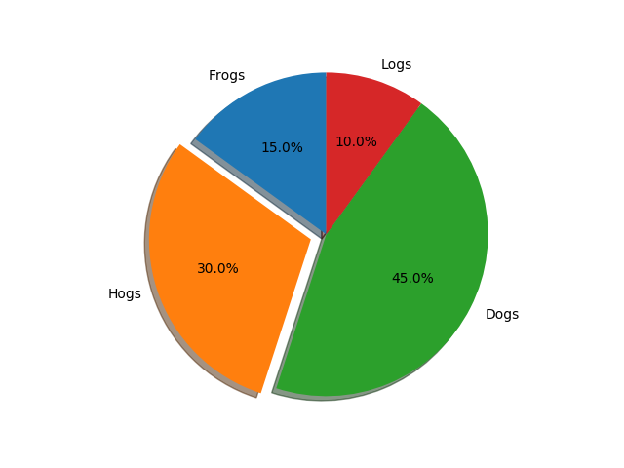
Pie Plot

Slide 35
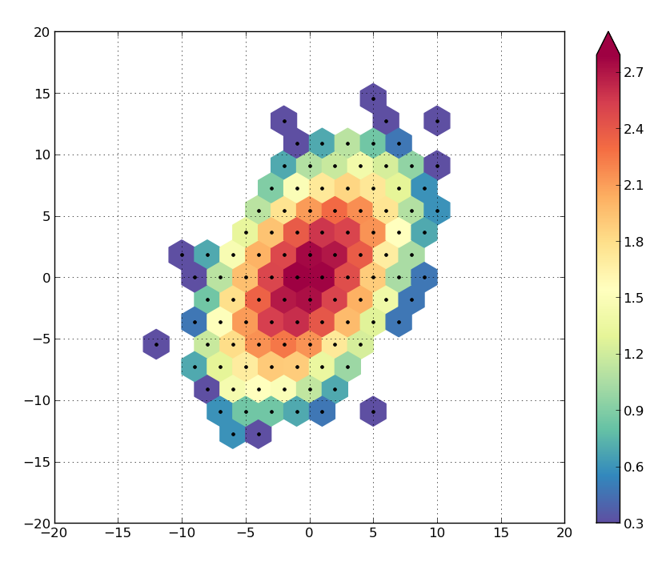
Hexbin Plot

Slide 36
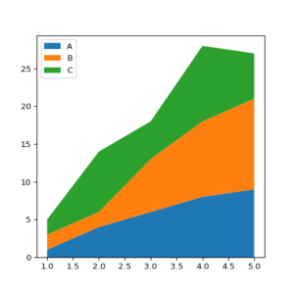
Area Plot

Slide 37
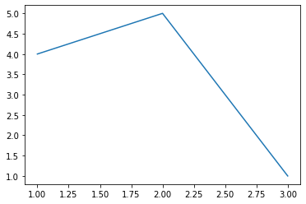
Create First Plot:
from matplotlib import pyplot as plt
plt.plot([1,2,3],[4,5,1])
plt.show

Slide 38
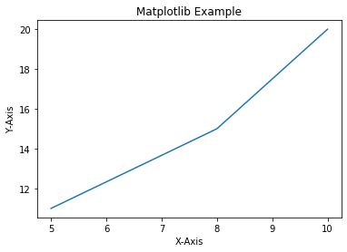
Add Labels and Title to Plot:
from matplotlib import pyplot as plt
x=[5,8,10]
y=[11,15,20]
plt.plot(x,y)
plt.title('Matplotlib Example')
plt.xlabel('X-Axis')
plt.ylabel('Y-Axis')
plt.show()

Slide 39
Add Styles to Plot:
from matplotlib import style
style.use('ggplot')
x1=[5,8,10]
y1=[12,16,23]
x2=[17,13,45]
y2=[15,20,30]
plt.plot(x1,y1,'g',label='Line One',linewidth=5)
plt.plot(x2,y2,'c',label='Line Two',linewidth=5)

Slide 40
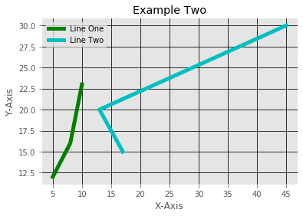
plt.title('Example Two')
plt.xlabel('X-Axis')
plt.ylabel('Y-Axis')
plt.legend()
plt.grid(True,color='k')
plt.show()

Slide 41
Bar Plot:
x1=[5,8,10]
y1=[12,16,23]
x2=[17,13,45]
y2=[15,20,30]
plt.bar(x1,y1,label='Example One')
plt.bar(x2,y2,label='Example Two')
plt.legend()
plt.xlabel('X-axis')
plt.ylabel('Y-axis')

Slide 42
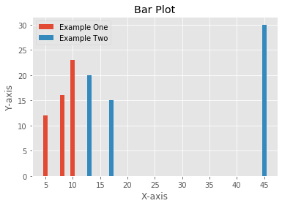
plt.title('Bar Plot')
plt.show()

Slide 43
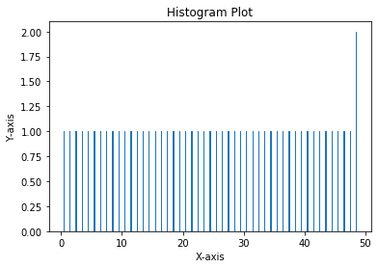
Histogram:
pa=range(50)
bins=range(50)
plt.hist(pa,bins,histtype='bar',rwidth=0.2)
plt.xlabel('X-axis')
plt.ylabel('Y-axis')
plt.title('Histogram Plot')
plt.show()

Slide 44
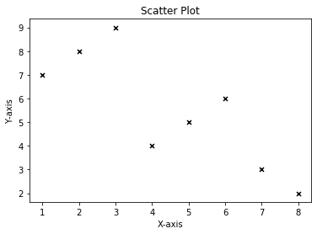
Scatter Plot:
x3=[1,2,3,4,5,6,7,8]
y3=[7,8,9,4,5,6,3,2]
plt.scatter(x3,y3,label='Arvind',color='k',s=25,marker='x')
plt.xlabel('X-axis')
plt.ylabel('Y-axis')
plt.title('Scatter Plot')
plt.show()

Slide 45
Stack Plot:
D=[1,2,3,4,5]
S=[7,8,6,11,7]
E=[2,3,4,3,2]
W=[7,8,7,2,2]
P=[8,5,7,8,13]
plt.plot([],[],color='m',label='D',linewidth=5)
plt.plot([],[],color='c',label='S',linewidth=5)
plt.plot([],[],color='r',label='E',linewidth=5)
plt.plot([],[],color='k',label='W',linewidth=5)
plt.plot([],[],color='g',label='P',linewidth=5)

Slide 46
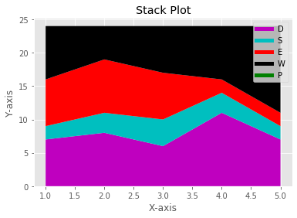
plt.stackplot(D,S,E,W,P,colors=['m','c','r','k','y'])
plt.legend()
plt.xlabel('X-axis')
plt.ylabel('Y-axis')
plt.title('Stack Plot')
plt.show()

Slide 47
Pie Plot:
slices=[7,2,4,3]
Name=['A','B','C','D']
clrs=['c','m','r','b']
plt.pie(slices,
labels=Name,
colors=clrs,
startangle=90,
shadow=True,
explode=(0,0.1,0,0),
autopct='%.2f%%'
)

Slide 48
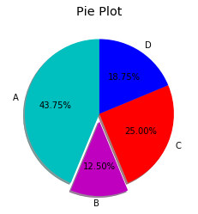
plt.title('Pie Plot')
plt.show()

Slide 49
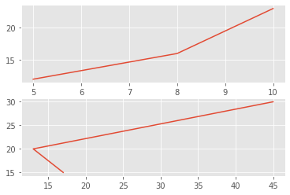
Working With Multiple Plots:
x1=[5,8,10]
y1=[12,16,23]
x2=[17,13,45]
y2=[15,20,30]
plt.subplot(211)
plt.plot(x1,y1)
plt.subplot(212)
plt.plot(x2,y2)
plt.show()

Slide 50
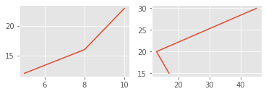
x1=[5,8,10]
y1=[12,16,23]
x2=[17,13,45]
y2=[15,20,30]
plt.subplot(221)
plt.plot(x1,y1)
plt.subplot(222)
plt.plot(x2,y2)
plt.show()

Slide 51
Plt.subplot(211)
2 means we have 2 plots in this plot.
1 means Horizontally we have only one plot
1 means this is plot number 1

